Slide 1
GPU-accelerated fractal imaging
Jeremy Ehrhardt
CS 81 - Spring 2009

Slide 2


Motivation
Typical reconstruction filters blur edges, detail
Original
Reduced 4x, then enlarged 4x
with Mitchell filter

Slide 3
Motivation
Fractal encoding
A scale-independent model of image
Find self-similar regions of image
Contractive transformations

Slide 4
Motivation
Decoding fractal representation
Any scale
Larger than original image
Preserves appearance of high-frequency detail
Improved visual quality

Slide 5
Motivation
Basic encoding algorithm
Divide image into small range blocks
Generate domain blocks from image somehow
For each range block
For each domain block
Find scale and offset for pixel luminance
R = t(D) = s * D + o
Pick domain with lowest mean squared error

Slide 6
Using the GPU
Encoding highly parallelizable
Range selections don’t depend on other ranges
Process multiple ranges at a time
Process multiple domains for a range at a time
Process multiple pixels in range, domain, or product at a time

Slide 7
Using the GPU
Decoding also parallelizable
Short number of iterations (~10)
Take transform list from encoding
Decide on output size
For each pixel in output
Source, scale, offset don’t change across iterations
Value depends only on image at previous iteration
Maps naturally to pixel shader

Slide 8
What I Did
Software encoder and decoder
Python, using NumPy fast array extension
GPU-assisted encoder
Most work done in GLSL pixel shaders
Implementations similar
Easy debugging
All images were decoded in software

Slide 9
Encoding times
Encoder | Domain size | Range size | Image dimensions | Time (seconds)
Software | 8 | 4 | 256 x 256 | 350
OpenGL | 8 | 4 | 256 x 256 | 52
Software | 4 | 2 | 256 x 256 | 5620
OpenGL | 4 | 2 | 256 x 256 | 176
Domain and range sizes are pixels along edge of a square
CPU: Intel Core 2 Duo @ 2.16 GHz
2 GB RAM @ 0.667 GHz
GPU: nVidia GeForce 7600 GT @ 0.56 GHz
256 MB RAM @ 0.7 GHz

Slide 10

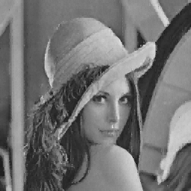
Results (no enlargement)
Tradeoff between speckles and blocking
Fractal encoder (GPU, 4:2)
Fractal encoder (GPU, 8:4)

Slide 11
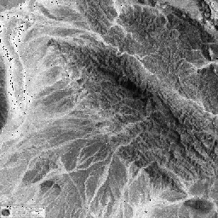
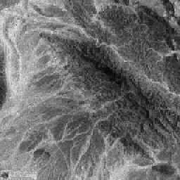
Results (no enlargement)
Fractal encoder (GPU, 4:2)
Fractal encoder (GPU, 8:4)

Slide 12
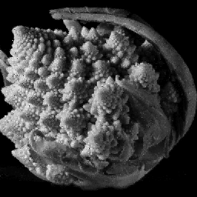

Results (no enlargement)
Fractal encoder (GPU, 4:2)
Fractal encoder (GPU, 8:4)

Slide 13


Results (2x enlargement)
Reduced 2x, then enlarged 2x
with fractal scaler (GPU, 4:2)
Reduced 2x, then enlarged 2x
with fractal scaler (GPU, 8:4)

Slide 14


Results (4x enlargement)
Reduced 4x, then enlarged 4x
with fractal scaler (GPU, 4:2)
Reduced 4x, then enlarged 4x
with fractal scaler (GPU, 8:4)

Slide 15

Side by Side
Reduced 2x, then enlarged 2x
with Mitchell filtering
Reduced 2x, then enlarged 2x
with fractal scaler (GPU, 8:4)

Slide 16
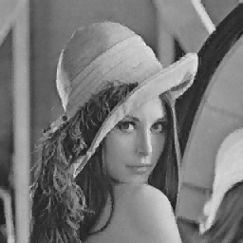
GPU vs CPU
GPU has speckle noise
Probably due to lower accuracy
CPU, 8:4
GPU, 8:4

Slide 17

GPU vs CPU
GPU has speckle noise
Probably due to lower accuracy
CPU, 4:2
GPU, 4:2

Slide 18
Accuracy issues
Iterative nature of decoding process would tend to magnify errors
Testing on double-precision GPU needed

Slide 19
Wish list
GPU-accelerated decoder
CUDA or OpenCL port

Slide 20
Conclusions
CPU encoder quality getting higher
Extremely slow
GPU encoder is fast but has accuracy issues
Where are they?
Can they be fixed or compensated for?
CUDA or OpenCL port would help here

